Slide 1

Institute Technology of Cambodia
Subject: Data mining
Lecturers : PHAUK Sokkhey and CHAN Sophal
Name: CHHOEM Sothy

Slide 2

TopIC: Matplotlib

Slide 3
Content

Slide 4
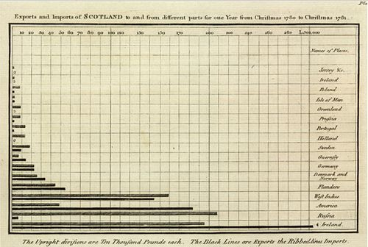
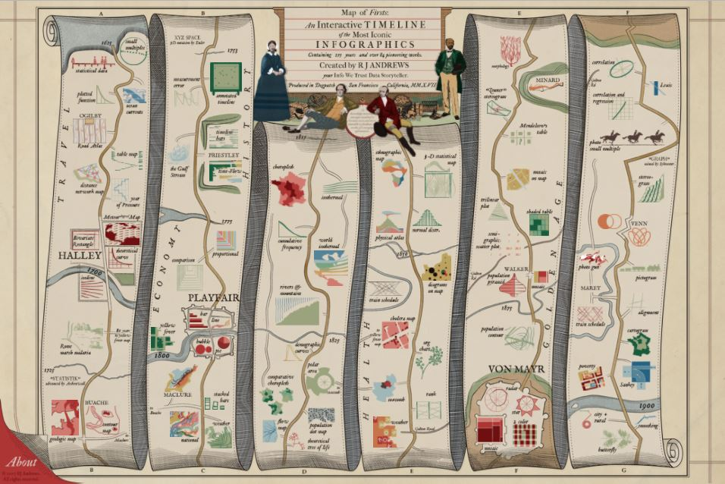
Data visualization
History
The earliest data table in known existence was created in 2nd century Egypt, cataloging astrological information to aide navigation practices of the day.
Many of the visualization techniques of today were invented during the industrial revolution, with the field making large strides in the mid-19th century.

Slide 5
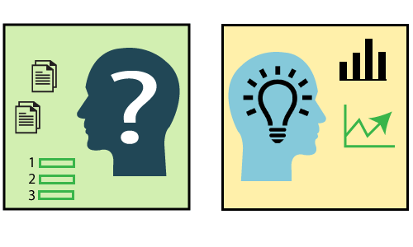

Data visualization (cont.)
What is data visualization?
Data visualization provides a good, organized pictorial representation of the data which makes it easier to understand, observe, analyze.
Advantages of data visualization
The advantages and benefits of good data visualization is another form of visual art that grabs our interest and keeps our eyes on the message.

Slide 6
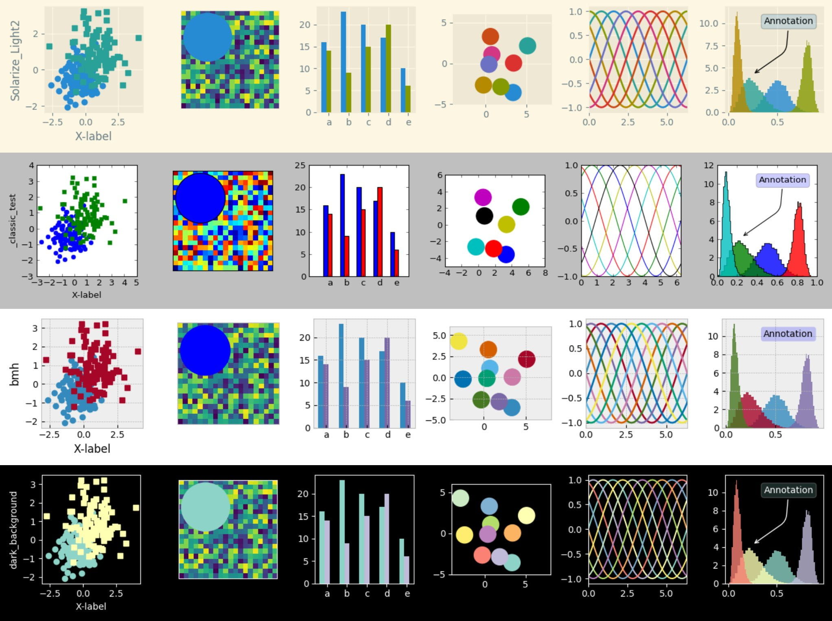
Matplotlip
Matplotlib is a cross-platform, data visualization and graphical plotting library for Python and its numerical extension NumPy. As such, it offers a viable open source alternative to MATLAB. Developers can also use matplotlib’s APIs (Application Programming Interfaces) to embed plots in GUI applications.

